Slide 1
Use of mobile technology in malaria elimination setting: A case study in Zanzibar
Mohamed H. Ali
ZANZIBAR MALARIA ELIMINATION PROGRAMME

Slide 2
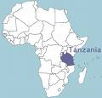
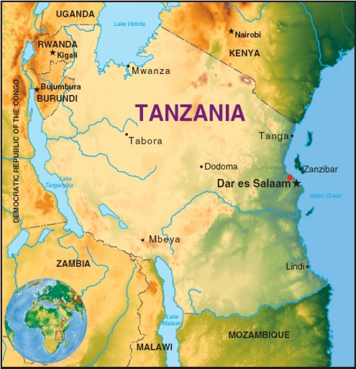
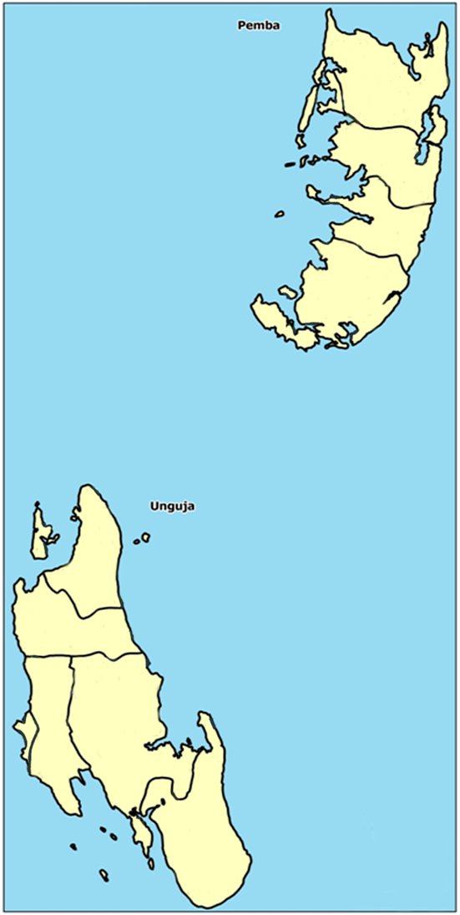
Zanzibar, United Republic of Tanzania
Pemba
Zanzibar:
1.3 m pop
2,500 km²
Transmission
Very low
Seasonality
Vectors
An. gambiae s.s
An. Arabiensis
Parasite
P. falciparum (> 95%)
P. malariae
ZANZIBAR
Unguja
Notes:
While malaria prevalence in Zanzibar has been reduced to unprecedented low levels (<1%) the persistence of endemic malaria transmission in surrounding areas, specifically Tanzania Mainland and Kenya, leaves these islands vulnerable to sudden outbreaks of malaria and re-establishment of ongoing, perennial malaria transmission.

Slide 3
Malaria Control Phases in Zanzibar
Health Facility trends: Malaria confirmed cases and positivity rate 1999-14
Gain Before ACT introduction
Gain after ACT and before VC scale up
Notes:
Evidence from that past 7 years shows that in Zanzibar malaria has been controlled and the country is now in a -elimination phase
Health Facility Data confirm that since 2006 SPR is largely below 5% (threshold for pre-elimination)
Repeated surveys data from 2006 onwards show an overall prevalence rate of <1%
Still evidence of increased seasonal transmission in some foci (hot spots) every year
Evidence of some localized outbreaks (2010)

Slide 4
Conceptual Framework for Malaria Surveillance in Zanzibar (and Response)
Epidemiological Malaria Surveillance
Passive Malaria Surveillance
Active Malaria Surveillance
MEEDS (Aggregated Weekly data)
MCN (Individual notification)
Re-ACD (Case based)
Re-ACD (Event based)
Pro-ACD
Outbreak Investigation and Response
Hotspot and risk group investigation and response
ACD: Active Case Detection; MCN: Malaria Case Notification
MEEDS: Malaria Epidemic Early Detection System;

Slide 5
Overview of Zanzibar MCN
Real Time Data
(Raw)
Sever
GIS
ZNZ M&E
DAR M&E
XL, SPSS, Octave, SAS
Donors
Patient
New CID
Patient Name
Shehia
13 Fields
RCD From Data
Patient Name
Shehia
CID
HH details
NMCR
10 remaining
Fields
Positive results
HF
DMSO
DMSO

Slide 6
Results
Data from January 2013 to December 2016
13,663 malaria cases notified by health facilities
10,631 (78% of notified) cases followed up at the household level
43,822 household contacts tested for malaria
2,304 (5%) tested positive for malaria
7,423 (57%) reported sleeping under a net the previous night
4,849 (37%) reported a history of travel outside Zanzibar in the past 30 days

Slide 7
Timeliness of case notification after diagnosis

Slide 8
Timeliness of cases follow-up at household level

Slide 9
HH members screening, positive detected, and positivity rate by month in 2013-16

Slide 10
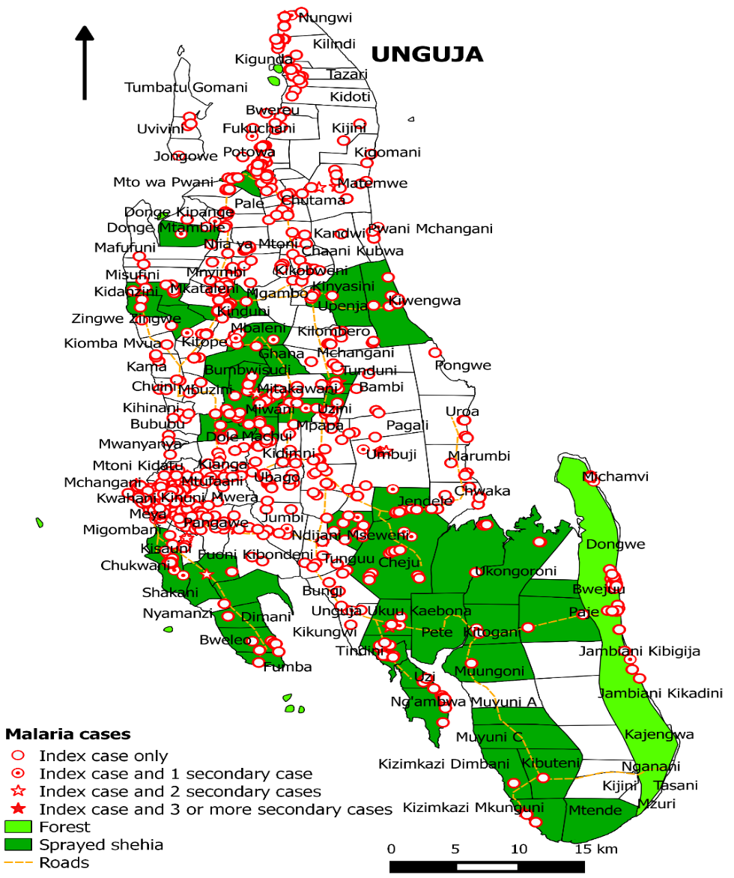
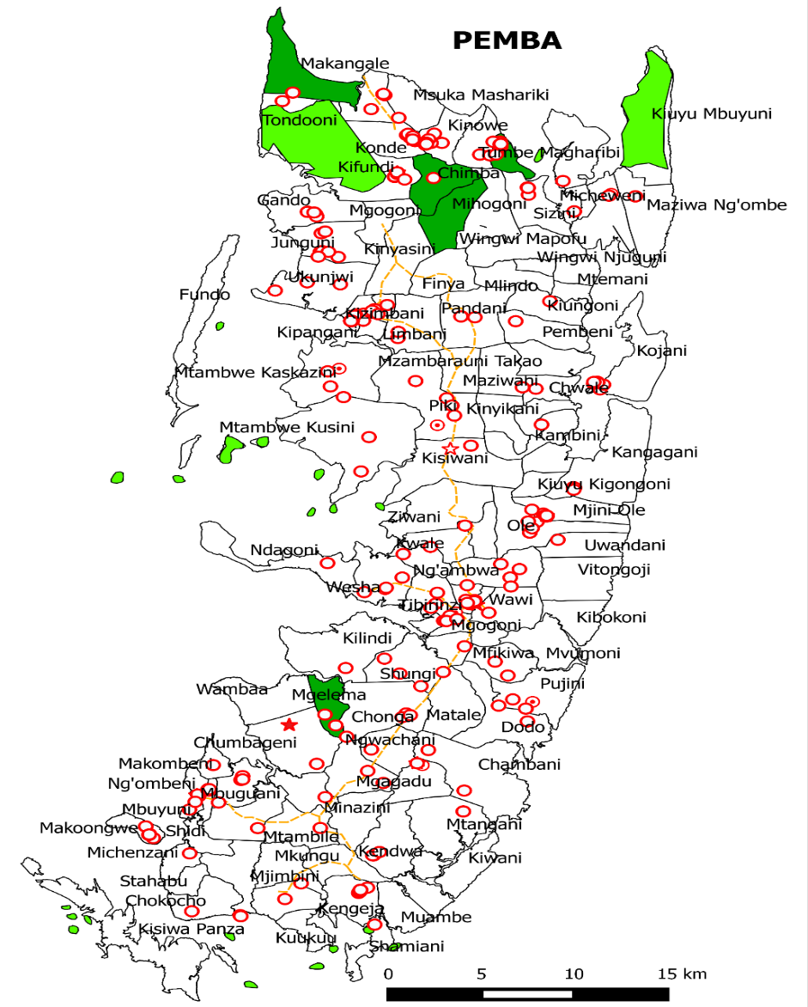
Where are the cases in 2016

Slide 11
Conclusion
The designed surveillance system demonstrates that active case detection and treatment of malaria cases is feasible
Routine targeted testing and treatment of population at risk alongside other preventive interventions is likely to reduce malaria transmission and malaria morbidity and improve malaria elimination efforts in Zanzibar

Slide 12
Acknowledgements

